Slide 1
Sorting Part 4
CS221 – 3/25/09

Slide 2
Sort Matrix
Name | Worst Time Complexity | Average Time Complexity | Best Time Complexity | Worst Space (Auxiliary)
Selection Sort | O(n^2) | O(n^2) | O(n^2) | O(1)
Bubble Sort | O(n^2) | O(n^2) | O(n) | O(1)
Insertion Sort | O(n^2) | O(n^2) | O(n) | O(1)
Shell Sort | O(n^2) | O(n^5/4) | O(n^7/6) | O(1)
Merge Sort | O(n log n) | O(n log n) | O(n log n) | O(n)
Bucket Sort
Quicksort

Slide 3
Bucket Sort
Bucket sort works by partitioning the elements into buckets and the return the result
Buckets are assigned based on each element’s search key
To return the result, concatenate each bucket and return as a single array

Slide 4
Bucket Sort
Some variations
Make enough buckets so that each will only hold one element, use a count for duplicates
Use fewer buckets and then sort the contents of each bucket
Radix sort (which I’ll demonstrate next)
The more buckets you use, the faster the algorithm will run but it uses more memory

Slide 5
Bucket Sort
Time complexity is reduced when the number of items per bucket is evenly distributed and as close to 1 per bucket as possible
Buckets require extra space, so we are trading increased space consumption for a lower time complexity
In fact Bucket Sort beats all other sorting routines in time complexity but can require a lot of space

Slide 6
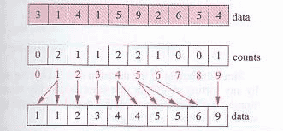
Bucket Sort
One value per bucket:

Slide 7
Bucket Sort Animation
http://www.cs.auckland.ac.nz/software/AlgAnim/binsort.html

Slide 8
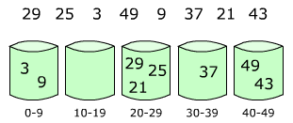
Bucket Sort
Multiple items per bucket:

Slide 9
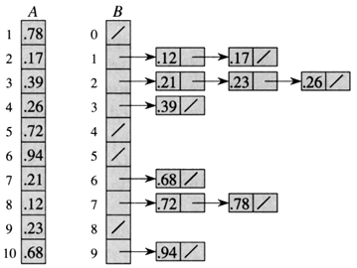
Bucket Sort
In array form:

Slide 10
Bucket Sort Algorithm
Create an array of M buckets where M is the maximum element value
For each item in the array to be sorted
Increment the bucket count for the item value
Return concatenation of all the bucket values

Slide 11
Pseudo Code
//init the variables
buckets = new array of size m
resultArray = new array of size array.length
resultIndex = 0
//set buckets to 0
For index = 0 to buckets.length-1
buckets[index] = 0
//increment each bucket based on how many items it contains
For index = 0 to array. length– 1
buckets[array[index]]++
//create the sorted array
For index = 0 to buckets. length-1
For elementCount = 0 to buckets[index]-1
resultArray[resultIndex++] = index

Slide 12
Bucket Sort Complexity
What is the time complexity?
What is the space complexity?
Is the data exchanged in-place?
Does the algorithm require auxiliary storage?

Slide 13
Sort Matrix
Name | Worst Time Complexity | Average Time Complexity | Best Time Complexity | Worst Space (Auxiliary)
Selection Sort | O(n^2) | O(n^2) | O(n^2) | O(1)
Bubble Sort | O(n^2) | O(n^2) | O(n) | O(1)
Insertion Sort | O(n^2) | O(n^2) | O(n) | O(1)
Shell Sort | O(n^2) | O(n^5/4) | O(n^7/6) | O(1)
Merge Sort | O(n log n) | O(n log n) | O(n log n) | O(n)
Bucket Sort | O(n) | O(n) | O(n) | O(m)
Quicksort

Slide 14
Radix Sort
Improves on bucket sort by reducing the number of buckets
Maintains time complexity of O(n)
Radix sort executes a bucket sort for each significant digit in the data-set
100’s would require 3 bucket sorts
100000’s would require 6 bucket sorts

Slide 15

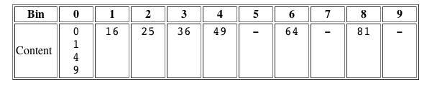
Radix Sort
Sort: 36 9 0 25 1 49 64 16 81 4
First Buckets:
Second Buckets:

Slide 16
Radix Sort Animation
http://www.cs.auckland.ac.nz/software/AlgAnim/radixsort.html

Slide 17
Why are they so fast?
What’s unique about bucket and radix sort?
Why are they faster than merge sort, quicksort, etc?

Slide 18
Why are they so fast?
They make no comparisons!
The only work we do is partitioning and concatenating

Slide 19
What’s the downside?

Slide 20
What’s the downside?
Works best for integers
Hard to generalize to other data types

Slide 21
Quicksort
Divide and conquer approach to sorting
Pick a pivot in the list
Ensure all elements to the left of the pivot are less than the pivot
Ensure all the elements to the right of the pivot are greater than the pivot
Recursively repeat this process on each sub-array

Slide 22
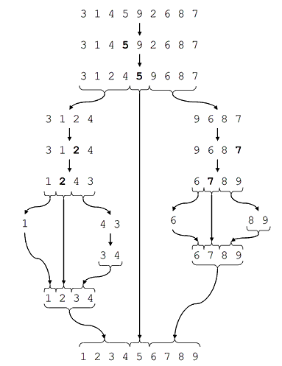
Quicksort

Slide 23
Quicksort Animation
http://coderaptors.com/?QuickSort

Slide 24
Quicksort Recursion
Basecase
Array is 0 or 1 elements
Recursive logic
Use quicksort on the left side of the pivot
Use quicksort on the right side of the pivot

Slide 25
Quicksort Algorithm
If the array is <= 1, return the array
Pick a pivot in the array
Partition the array into two arrays, one less than and one greater than the pivot
Quicksort the less array
Quicksort the greater array
Concatenate less array, pivot and greater array

Slide 26
How would you pick the pivot?
Goal is to pick a pivot that will result in two arrays of roughly equal size

Slide 27
Picking the Pivot
Select an item at random
Look at all of the items and pick the median
Select first, last or middle item
Select first, last and middle item and pick the median

Slide 28
Simple Quick Sort Pseudo Code
If (array.length <= 1)
return array
pivot = array[0]
For index = 1 to array.length
if array[index] <= pivot
less[lessIndex++] = array[index]
else
greater[greaterIndex++] = array[index]
return concatenate(quicksort(less), pivot, quicksort(greater)

Slide 29
Quicksort Complexity
What is the time complexity?
How many comparisons?
How many exchanges?
What’s the worst case?
What is the space complexity?
Is the data exchanged in-place?
Does the algorithm require auxiliary storage?

Slide 30
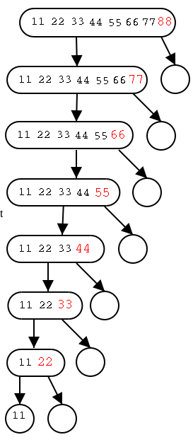
Worst Case Time Complexity
We will get O(n^2) we partition very poorly such that one sub-array is always empty

Slide 31
Space Complexity
Less and Greater arrays require n space
Recursive calls require log n space on the call stack
Result arrays in concat require half as much space in each call – requires n space
On average O(n)
Worst case O(n^2)!
Matches worst case time complexity

Slide 32
Quicksort Improved
Simple version above requires additional space because of the auxiliary arrays
We can reduce this by in-place partitioning
O(log n) on average
O(n) in the worst case

Slide 33
Sort Matrix
Name | Worst Time Complexity | Average Time Complexity | Best Time Complexity | Worst Space (Auxiliary)
Selection Sort | O(n^2) | O(n^2) | O(n^2) | O(1)
Bubble Sort | O(n^2) | O(n^2) | O(n) | O(1)
Insertion Sort | O(n^2) | O(n^2) | O(n) | O(1)
Shell Sort | O(n^2) | O(n^5/4) | O(n^7/6) | O(1)
Merge Sort | O(n log n) | O(n log n) | O(n log n) | O(n)
Bucket Sort | O(n) | O(n) | O(n) | O(m)
Quicksort | O(n^2) | O(n log n) | O(n log n) | O(n) O(log n) average

Slide 34
